Slide 1
Think Before You Loop: "Big O Thinking" for PowerShell devs
Jonas Sommer Nielsen

Slide 2


Many thanks to our sponsors:

Slide 3

Jonas Sommer Nielsen
PowerShell Summit 2015
2021 KMD - Cloud Architect
Aarhus, Denmark

Slide 4
Think. Measure. Profile.
Thinking is free.
Measuring is cheap.
Profiling is for when your already in trouble.
Notes:
"Before you write a loop, ask: how many will this become?" "That's the whole talk. Think before you loop — the slow version is always one nested loop away." "Three tools, in this order: Think, Measure, Profile. Thinking is free. Measuring is cheap. Profiling is for when you've already lost."

Slide 5
So, what is BIG O?
Big O O(n)
worst case Time or Space complexity
N = biggest number
M = Other numbers?
1 = Constants We are looking for the worst case, so thow away everything but the biggest “number”
Notes:
Big O (O): Describes the upper bound of an algorithm's growth rate. It represents the worst-case scenario, indicating that the algorithm's runtime will not grow faster than a certain rate
Big Omega (Ω): Describes the lower bound of an algorithm's growth rate. It represents the best-case scenario, meaning the algorithm will not run faster than this bound
Big Theta (Θ): Describes both the upper and lower bounds, providing a tight bound on the growth rate. If an algorithm is Θ(f(n)), it means its runtime grows exactly at the rate of f(n), within constant factors

Slide 6
Every loop inside a loop multiplies.
If you spot it before you write it, you save hours.
If you spot it after, you reach for Measure-Command or the Profiler.

Slide 7
Demos
We love Demos!

Slide 8
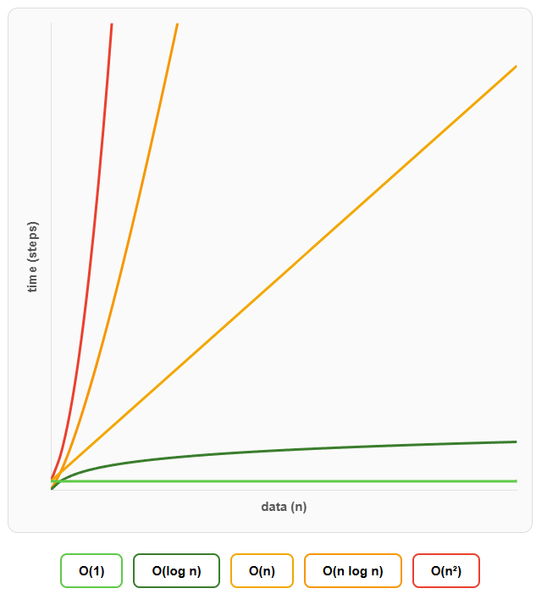
Big O notation
O(1)
O(log n)
O(n)
O(n log n)
O(n²)

Slide 9
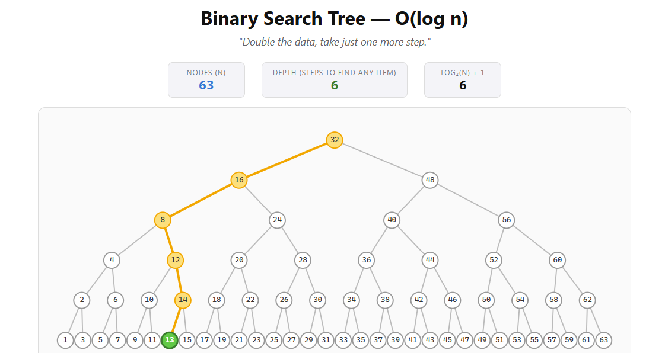
What does Log n mean?

Slide 10
PowerShell scripting performance considerations
https://learn.microsoft.com/en-us/powershell/scripting/dev-cross-plat/performance/script-authoring-considerations
Notes:
https://learn.microsoft.com/en-us/powershell/scripting/dev-cross-plat/performance/script-authoring-considerations

Slide 11
Think. Measure. Profile.
Thinking is free.
Measuring is cheap.
Profiling is for when your already in trouble.
Notes:
"Before you write a loop, ask: how many will this become?" (beat) "That's the whole talk. Think before you loop — the slow version is always one nested loop away." (beat) "Three tools, in this order: Think, Measure, Profile. Thinking is free. Measuring is cheap. Profiling is for when you've already lost." (beat) "Thank you. Questions?"

Slide 12
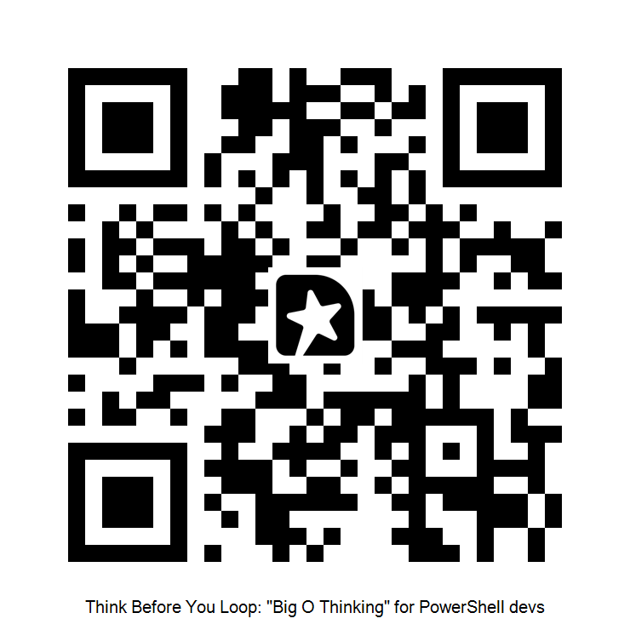
Please 🙏 GIVE ME FEEDBACK
Q&A
15 minutes

Slide 13
GIVE ME FEEDBACK
INSERT YOUR SESSION QRCODE HERE

